Slide 1
DATA BREACH
YASH , BHOOMI , VIRAJ , ABHIROOP

Slide 2
Overview
As the universe of potential cyber threats continues to expand with greater speed, you need some form of cybersecurity services to protect every point of vulnerability within your organization.
Our company provide value and expertise in everything from security strategy and risk management to network penetration testing and security architecture design.

Slide 3
Threats
There are three main challenges that businesses are running into with big data:
Protecting sensitive and personal information.
Data rights and ownership.
Not having the talent (i.e. data scientists) to analyze the data.

Slide 4
Offerings
Education and Awareness to address the weakest link in your security chain.
Identity and Access Management to ensure that only trusted employees, partners and consumers can seamlessly access your environment.
Security Architecture and Implementation to help select the right technology and solutions for your environment.

Slide 5
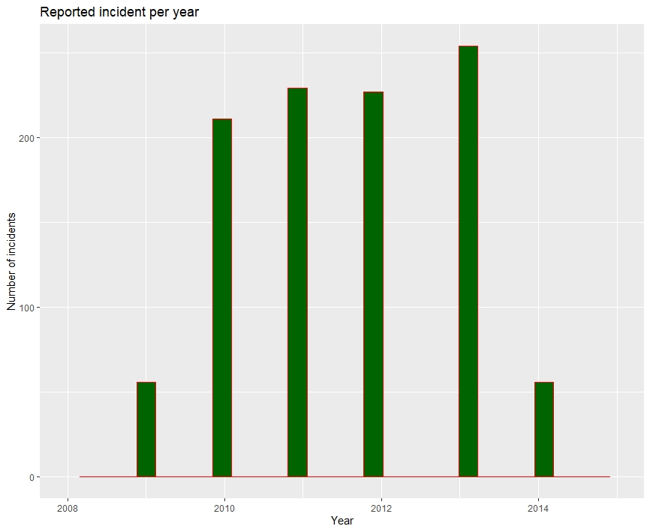

Slide 6
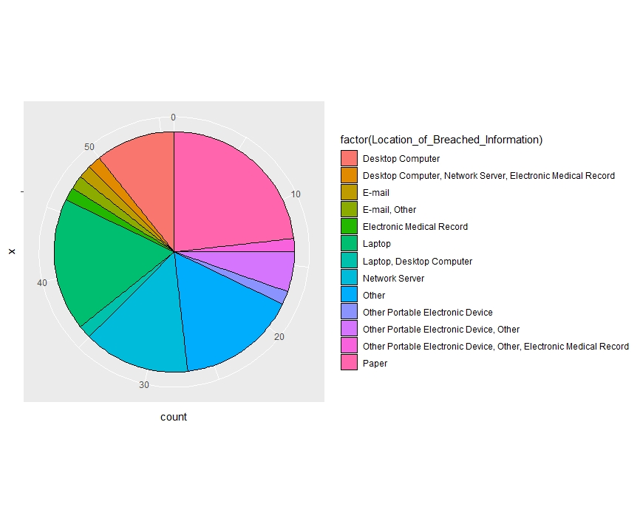

Slide 7
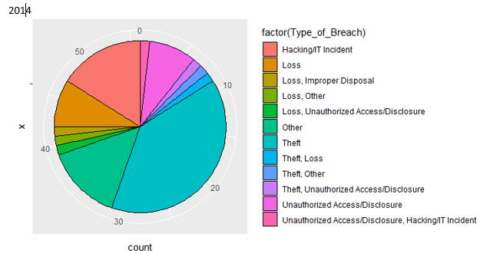
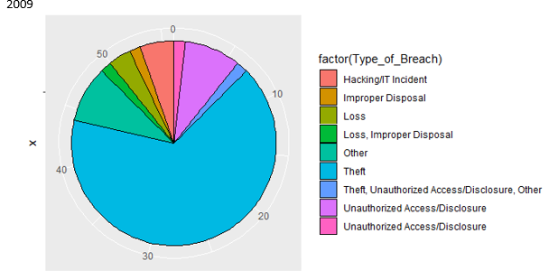
Types of breaches 2014 vs 2009

Slide 8
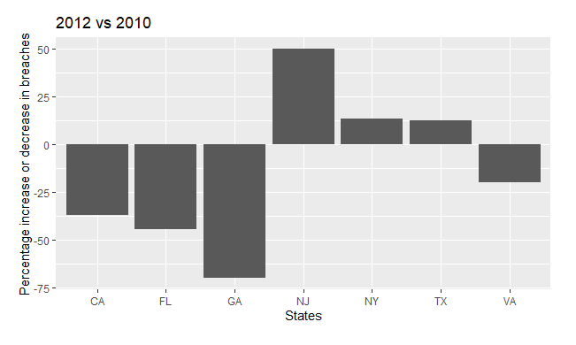
Percentage change in breaches 2010 vs 2012 for 7 states

Slide 9
DATA STRUCTURES USED
VECTOR
DATA FRAME
MATRIX

Slide 10
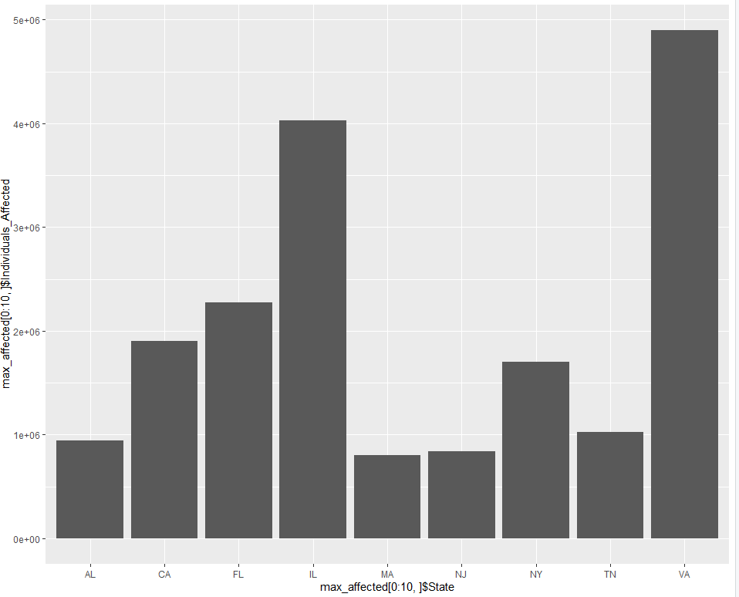
No. of States affected.

Slide 11
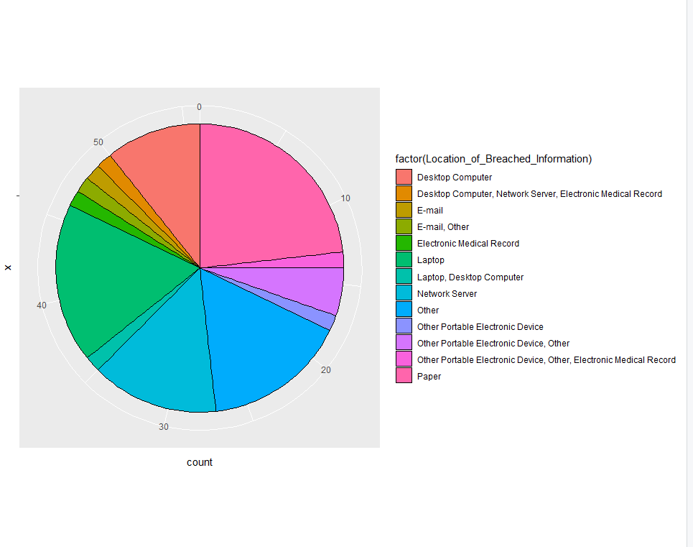
Pie chart showing the areas breached .

Slide 12
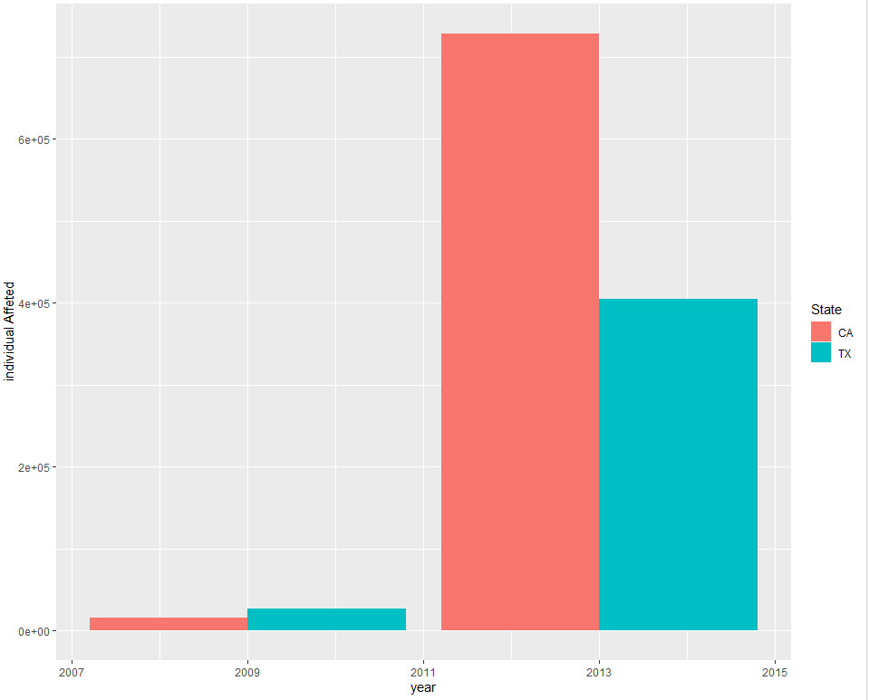
STACKED CHART

